Slide 1
Biostatistics III Analysis of Categorical Data
Lecture 16: Poisson Regression

Slide 2
Outline
Simple Poisson Regression
Multiple Poisson Regression
Your reading
Fleiss, Chapter 12.1 (optional), 12.2, 12.3
https://onlinelibrary.wiley.com/doi/pdf/10.1002/0471445428.ch12

Slide 3
Simple Poisson Regression

Slide 4
Poisson Distribution
The Poisson distribution is perhaps the second most frequently used discrete distribution after the binomial distribution, named after the French mathematician Siméon Denis Poisson (1791 – 1840).
This distribution is often used to model count data.
Examples:
Distribution of number of death due to lung cancer;
Distribution of number of leukemia;
Distribution of number of ED visits, hospitalizations….

Slide 5
Poisson Distribution (I)
The probability function of Poisson distribution:
where μ is the mean of Y, that is E(Y) = μ.
And also, Var(Y) = μ.
For a Poisson distribution, the minimum value is 0 and the upper limit is +∞.
To denote the above Poisson distribution, Y ~ Poisson(μ).

Slide 6
Poisson Distribution (II)
If we look at the probability of y events in a time period t for a Poisson random variable, we could write:
What does λ represent here?

Slide 7
Poisson Distribution (III)
What does λ represent here?
A rate, the expected number of events in a given population over a given period time.
Often expressed in units such as events per thousand person-years.
The Poisson distribution is the prototype for assigning probabilities of observing any number of events.

Slide 8
Person-year and rate (I)
Just in case you don’t know how to calculate Person-years,
One person-year is a unit of time defined as one person being followed for one year.
Person-years for a sample of n subjects is calculated as the total years followed for the n subjects, where each subject could have different follow-up time.
A real simple example: suppose we have 5 subjects, two of the subjects were followed for 2 years, and two of them are followed for 3 years and the fifth subject was followed for 3.8 years; then
person-years = 2*2 + 2*3 + 3.8 = 13.8 years.

Slide 9
Person-year and rate (II)
Just in case you don’t know how to calculate rate,
Also suppose that we observe one event during the follow-up period, then

Slide 10
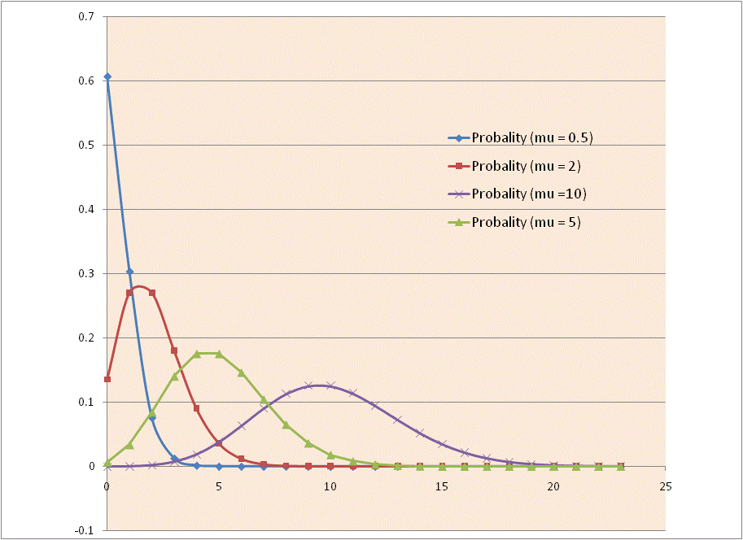
Poisson Distribution
Distribution of Poisson distribution with different mean μ.

Slide 11
Review: Linear Regression and Logistic Regression
Let Y is the dependent variable of interest and x is a predictor variable,
In simple linear regression, we have
In simple logistic regression, we have
Q: What do we model in a Poisson regression?

Slide 12
Simple Poisson Regression Model
Q: What do we model in a Poisson regression?
A: Log of conditional mean of Y given x.
Let Y be a Poisson count for a given unit of time, then μ(x) = λ(x) .
In a simple Poisson regression, we have
So this is also called a “log-linear” model.

Slide 13
Parameter Interpretation (I)
In a simple Poisson regression, we have
How do we interpret β₀ and β₁ ?
In the simple case of x being a binary variable

Slide 14
Parameter Interpretation (I)
In a simple Poisson regression, we have
How do we interpret β₀ and β₁ ?
In the simple case of x being a binary variable

Slide 15
Parameter Interpretation (II)
How do we interpret β₀ and β₁ ?
By subtraction, we have
What if x is continuous variable?

Slide 16
Parameter Interpretation (III)
How do we interpret β₀ and β₁ ?
What if x is continuous variable?
For each additional unit increase of x, β₁ is the increase in log rate in Y;
Correspondingly, exp(β₁) is the rate ratio associated with one unit increase in x.
In terms of rate, for each additional unit increase of x, there is an exp(β₁) fold increase in the rate of Y.

Slide 17
Model Construction – Include Offset (I)
What if we have data that each observation has different period of time?
For example, we look at number of ED visits when subjects are enrolled in Oregon Health Plan, however, each subjects are enrolled in the plan for different length of time…
How do we incorporate this different length of time?

Slide 18
Model Construction – Include Offset (I)
What if we have data that each observation has different period of time?
For example, we look at number of ED visits when subjects are enrolled in Oregon Health Plan, however, each subjects are enrolled in the plan for different length of time…
How do we incorporate this different length of time?
Note we have:
Then

Slide 19
Model Construction – Include Offset (II)
That is, to incorporate the different lengths in the model,
We have one more term in the model and this term is called offset, a known term in the model since t(x) is known from the dataset.

Slide 20
Test for Significance in Parameter (I)
To test the significance of model parameters:
Wald test
under null hypothesis that

Slide 21
Test for Significance in Parameter (II)
To test the significance of model parameters:
Likelihood ratio test (LRT)
and G has a chi-square distribution under null hypothesis
Both tests are best when μ(x) is relatively large.
where df = difference in the number of parameters
between the two models.

Slide 22
Example: Smoking and Lung Cancer

Slide 23
Data
This is a subset of data from the study of Doll (1971) concerning cigarette smoking and lung cancer in British physicians.
Cigarettes/Day* | Person-Years | No of cases
0 | 1421 | 0
5.2 | 927 | 0
11.2 | 988 | 2
15.9 | 849 | 2
20.4 | 1567 | 9
27.4 | 1409 | 10
40.8 | 556 | 7
* Mean value within intervals of cigarette consumptions.

Slide 24
Objective
Question of interest:
We are interested in the relationship between cigarette smoking and lung cancer rate.
We first look at cigarette smoking as a discrete variable, and then as a continuous variable.

Slide 25
Cigarette as a Binary Variable
Just as an illustrative example, we first dichotomize the variable Cigarettes/Day as:
heavysmoker = 1 if Cigarettes/Day > 20.4
heavysmoker = 0 if Cigarettes/Day <= 20.4
Fit a Poisson regression model using R:
lung$heavysmoker <- ifelse(lung$cigday>20.4,1,0)
lung.mod<-glm(ncases~heavysmoker + offset(logptyears),
data=lung,
family="poisson")
summary(lung.mod)

Slide 26
R Code and Output (I)
So the fitted rates

Slide 27
R Code and Output (II)
In general, how do we perform a likelihood Ratio test for Poisson regression?
lung.red<-glm(ncases~offset(logptyears),
data=lung,
family="poisson")
lrtest(lung.mod, lung.red)

Slide 28
Interpreting the Parameter (I)
So the fitted rates
Now let’s look at interpretation:
When heavysmoker = 0,
which indicates that the predicted lung cancer rate among non-heavy smoker is

Slide 29
Interpreting the Parameter (II)
Now let’s look at interpretation:
The slope coefficient, indicates that when comparing heavy smoker vs. non-heavy smoker, the rate ratio for lung cancer is:
That is, rate of lung cancer for heavy smokers is 3.827 times the rate of lung cancer for non-heavy smokers.

Slide 30
Cigarette as a Continuous Variable
Question of interest:
We are interested in the relationship between cigarette smoking and lung cancer rate.
Now let us look at cigarette smoking as a continuous variable.

Slide 31
R Code and Output (I)
lung.modc<-glm(ncases~cigday + offset(logptyears),
data=lung,
family="poisson")
summary(lung.modc)

Slide 32
Interpreting the Parameter (I)
So the fitted rates
Now let’s look at interpretation:
When CigDay = 0,
which indicates that the predicted lung cancer rate among non-smoking population is

Slide 33
Interpreting the Parameter (II)
Now let’s look at interpretation:
The slope coefficient, indicates that for each additional cigarette per day, there is an 1.078 times increase in the lung cancer rate: (or 7.8% increase)
For each additional pack of 20 cigarettes per day, there is an 4.46 times increase in the lung cancer rate:

Slide 34
Confidence Intervals for Parameters
We use normal theory to compute CI for parameters.
So 95% CI for slope (and intercept) terms are:
exp(coef(lung.modc))
# Lower bound of RR
exp(0.07485 + qnorm(0.05 / 2) * 0.01564)
# Upper bound of RR
exp(0.07485 + qnorm(1-0.05 / 2) * 0.01564)
To get the 95% CI for the rate ratio:
So for each additional cigarettes per day, there is an 1.08 times increase (95% CI 1.05, 1.11 ) in the lung cancer rate.
Notes:
Irr stands for incidence rate ratio

Slide 35
Computing Rate Ratio
Get rate ratio from R
For each additional 10 cigarettes per day
exp(10*0.07485)
# Lower bound of RR
exp(10*(0.07485 + qnorm(0.05 / 2) * 0.01564))
# Upper bound of RR
exp(10*(0.07485 + qnorm(1-0.05 / 2) * 0.01564))
[1] 2.113827 [1] 1.555756 [1] 2.872085
For each additional 20 cigarettes per day
exp(20*0.07485)
# Lower bound of RR
exp(20*(0.07485 + qnorm(0.05 / 2) * 0.01564))
# Upper bound of RR
exp(20*(0.07485 + qnorm(1-0.05 / 2) * 0.01564))
[1] 4.468264 [1] 2.420377 [1] 8.248874
Notes:
Irr stands for incidence rate ratio

Slide 36
Predicted Rates with Confidence Interval (I)
How do we get the predicted rate of lung cancer at a particular value of CigDay = a and its 95% CI?

Slide 37
Predicted Rates with Confidence Interval (I)
How do we get the predicted rate of lung cancer at a particular value of CigDay = a and its 95% CI?

Slide 38
Predicted Rates with Confidence Interval (II)
Get predicted rate from R
For smoking 10 cigarettes per day
exp(-0.23152+10*0.07485)
# Now that we are working with a linear combination of the intercept and cigdays, we need to do something different to get the confidence interval. We cannot just add the standard errors of the intercept and cigdays.
# We can use the glht function in the multcomp package to create a linear combination:
lc<-glht(lung.modc,linfct=t(c(1,10)))
# We can then find the confidence interval of this linear combination:
aa <- confint(lc)
# Lower bound of RR
exp(aa$confint[2])
# Upper bound of RR
exp(aa$confint[3])

Slide 39
Predicted Rates with Confidence Interval (III)
R output for previous slide

Slide 40
Predicted Rates and Rate Ratio
Note we have
What is the relationship between the predicted rates and rate ratio?

Slide 41
SAS Code
data lungca;
input CigDay PYears Ncases;
Ptyears = PYears/1000;
logPtyears = log(Ptyears);
datalines;
0 1421 0
5.2 927 0
11.2 988 2
15.9 849 2
20.4 1567 9
27.4 1409 10
40.8 556 7
;
Define 1000 person-years
proc genmod data = lungca;
model Ncases = CigDay/
link = log dist = poi
offset = logPtyears type3;
run;
Define offset

Slide 42
SAS Output (I)
Model Information
Data Set | WORK.LUNGCA
Distribution | Poisson
Link Function | Log
Dependent Variable | Ncases
Offset Variable | logPtyears
LR Statistics For Type 3 Analysis
Source | DF | Chi-Square | Pr > ChiSq
CigDay | 1 | 24.01 | <.0001
This table is obtained by specifying type3 in the model statement in SAS.

Slide 43
SAS Output (II)
Analysis Of Parameter Estimates
Parameter | DF | Estimate | Standard Error | Wald 95% Confidence Limits |  | Chi-Square | Pr > ChiSq
Intercept | 1 | -0.2315 | 0.4540 | -1.1214 | 0.6583 | 0.26 | 0.6101
CigDay | 1 | 0.0748 | 0.0156 | 0.0442 | 0.1055 | 22.90 | <.0001
Scale | 0 | 1.0000 | 0.0000 | 1.0000 | 1.0000
NOTES: SAS also provide confidence intervals based on the profile likelihood function. This confidence interval may be more accurate than the Wald CI but the computation is iterative and can consume a relatively large amount of CPU time.

Slide 44
SAS Code for Predicted Rates
SAS provides estimates of predicted rates:
.
proc genmod data = lungca;
model Ncases = CigDay/link = log dist = poi offset = logPtyears
type1 covb;
/* get increase factor for each additional 20 cigarettes/day */
estimate "increase factor cigday = 20" CigDay 20/exp;
/* get predicted rates for smoking10 and 20 cigarettes a day */
estimate "predicted rate cigday = 10" intercept 1 CigDay 10/exp;
estimate "predicted rate cigday = 20" intercept 1 CigDay 20/exp;
run;

Slide 45
SAS Output for Predicted Rates
Contrast Estimate Results
Label | Estimate | Standard Error | Alpha | Confidence Limits |  | Chi-Square | Pr > ChiSq
increase factor cigday = 20 | 1.4969 | 0.3128 | 0.05 | 0.8839 | 2.1100 | 22.90 | <.0001
Exp(increase factor cigday = 20) | 4.4679 | 1.3975 | 0.05 | 2.4202 | 8.2479
predicted rate cigday = 10 | 0.5169 | 0.3171 | 0.05 | -0.1046 | 1.1385 | 2.66 | 0.1031
Exp(predicted rate cigday = 10) | 1.6769 | 0.5318 | 0.05 | 0.9007 | 3.1221
predicted rate cigday = 20 | 1.2654 | 0.2096 | 0.05 | 0.8546 | 1.6762 | 36.45 | <.0001
Exp(predicted rate cigday = 20) | 3.5445 | 0.7428 | 0.05 | 2.3505 | 5.3450

Slide 46
Multiple Poisson Regression

Slide 47
Model (I)
When we have more than one independent variables, we have a multiple Poisson regression model... (vector notation).
where

Slide 48
Model (II)
With more than one independent variables,
As in simple Poisson regression, β₀ is the log of the predicted rate of Y when all the other variables = 0, and exp(β₀) is the predicted rate when all the other variables = 0.
For β_{i}, i = 1 to p, exp(β_{i}) is the rate ratio per unit increase in x_{i}, after controlling for all the other variables in the model.
For categorical variables, we need to create design variables.

Slide 49
Example: Nursing Home

Slide 50
Background
Consider the following data on nursing home, collected by the department of health and social service of the state of New Mexico, covering n = 52 of the 60 licensed nursing facilities in New Mexico in 1988.
Problem of interest: whether nursing homes in rural areas tend to have fewer beds per patient population than those in urban areas, after adjusting for other factors affecting hospital facilities.
Outcome: # of beds, and
Other variables:
Annual total patient care revenue (PCREV, in millions),
Annual nurse salary (NSAL, in millions),
Annual facilities expenditure (FEXP, in millions),
An indicator for whether or not rural location (Yes =1, No = 0).
Annual total patient days (TDAYS, in hundreds).

Slide 51
Offset Variable for the Model
Model only with rural indictor
Assume that expected number of beds at each nursing home is proportional to the total patient days, TDAYS, then TDAYS serves as the offset variable in the model.
Here we need to use logTDAYS = log(TDAYS) as the offset variable.
The rural indicator variable is categorical with two levels so we have one design variable.

Slide 52
Model with Rural Indictor Only
nursing.rural<-glm(BED~RURAL + offset(log(TDAYS)),
family=poisson,
data=nursing)
summary(nursing.rural)
confint(nursing.rural)
So exp(β₁) = exp(-0.064) = 0.938 with 95% CI (exp(-0.1212), exp(-0.0069)) = (0.886, 0.993) – this is the crude estimate.
Rural nursing home tends to have few beds and the rate ratio is 0.938. That is, rural nursing home has 0.94 times of beds (per patient-days), of those of urban nursing homes.

Slide 53
Variable Selection for Poisson Regression
About selection of variables for a Poisson Regression, we could use similar steps as in a logistic regression.
We could use similar idea to assess confounding.
For parameter interpretation with interaction, we also use similar ideas to those from logistic regression. Just instead of odds ratio or odds, we would say that, at a particular level of a third variable, the rate ratio (categorical variable) is... or for each additional unit of a continuous variable, the rate increases by a fold of ...
Any two nested models could be compared by using LRT.

Slide 54
The Model
Suppose, after a careful selection of variables, we come to a model:

Slide 55
R Code and Output
nursing.mult<-glm(BED~RURAL + PCREV*FEXP + NSAL*FEXP + offset(log(TDAYS)),
family=poisson,
data=nursing)
summary(nursing.mult)
confint(nursing.mult)

Slide 56
The Model
So in this step, after controlling all the other variables in the model, variable RURAL remains to be very significant (p < 0.001), and rural nursing homes tend to have fewer beds than urban nursing homes (rate ratio = exp(-0.145) = 0.865)).
Now the question is: Does the model have an overall goodness of fit?

Slide 57
Test Goodness of Fit
Recall that we used chi-square test based on deviance and Pearson’s chi-square to test for goodness of fit in logistic regression.
We would use the same tests in Poisson regression.
The distribution of the statistics D and X² under the assumption that the fitted model is correct in all aspects is:
where p is the number of non-intercept parameters in the
model.
For a Poisson model, test for goodness of fit based on deviance is preferred as it usually provides a better approximation of normality.

Slide 58
R Code for Goodness of Fit
After fitting a Poisson regression model:
# Test based on deviance
sum(nursing.mult$deviance)
pchisq(nursing.mult$deviance, df=nursing.mult$df.residual, lower.tail=FALSE)
[1] 205.085 [1] 2.657744e-22
# Test based on Pearson residuals
sum(residuals(nursing.mult, type="pearson")^2)
pchisq(220.999, df=nursing.mult$df.residual, lower.tail=FALSE)
[1] 220.999 [1] 4.556828e-25
A good fit?

Slide 59
Over-dispersion (I)
For a correctly specified model, the Pearson chi-square statistic and the deviance, divided by their degrees of freedom, should be approximately equal to one.
Now we have
D = 205.0848
df = 45
When their values are much larger than one, the assumption of Poisson variability is not valid and the data are said to exhibit over-dispersion.

Slide 60
Over-dispersion (II)
Actually, in practice, it is rare to have a Poisson distribution with mean equal to variance and it is the norm to handling over-dispersion in Poisson regression.
So when we work with Poisson regression, after we have done all relevant check for our models (entering all important terms, interactions, confounding variables, correct scales of continuous variables, no multi-colinearity, no outliers... etc),
Tests for Goodness of fit still does not show a good fit and we need to correct for over-dispersion.

Slide 61
Over-dispersion (III)
To correct for over-dispersion and estimate “Dispersion parameter”:
One way of correcting over/under-dispersion is to multiply the covariance matrix by either dispersion parameter, which is easy to implement.
Note that the parameter estimates are not changed by this method. However, their standard errors are adjusted for over/under dispersion, affecting their significance tests.

Slide 62
R Code --- Over-dispersion (I)
#The quasipoisson differs from the poisson family in that the dispersion parameter is not fixed at one, so it can be used to model overdispersion.
# the scale parameter was obtained using Pearson’s residuals.
nursing.mult.qp<-glm(BED~RURAL + PCREV*FEXP + NSAL*FEXP + offset(log(TDAYS)),
family=quasipoisson,
data=nursing)
summary(nursing.mult.qp)
Notes:
IRLS stands for iteratively reweighted least squares

Slide 63
Interpreting the Model
So now, after controlling all the other variables in the model, variable RURAL remains to be borderline significant (p = 0.068), and rural nursing homes tend to have fewer beds than urban nursing homes (rate ratio = exp(-0.145) = 0.865)).

Slide 64
Hierarchical Model
Another way to correct under dispersion is by using hierarchical model.
For Poission regression, Y ~ Poisson(μ). If we further assume that μ ~ Gamma distribution, then marginally, Y has a negative binomial distribution.
It is technical to understand the model, but it is easy to implement this model in SAS and R.
Interpretation of coefficients from a negative binomial regression is the same as those from a Poisson model.

Slide 65
R Code --- Over-dispersion (II)
# glm.nb is found in the package MASS
nursing.mult.nb<-glm.nb(BED~RURAL + PCREV*FEXP +
NSAL*FEXP + offset(log(TDAYS)),
data=nursing)
summary(nursing.mult.nb)
Notes:
Alpha is the estimate of the dispersion parameter. If the dispersion parameter equals zero, the model reduces to simpler poisson model. Below has a likelihood ratio test for testing whether the dispersion parameter equals to zero or not. If the test is significant, should use negative binomial model than a poisson model.

Slide 66
SAS Code --- Over-dispersion
SAS Code:
proc genmod data = nursing ;
class RURAL (param = ref ref = first);
model BED = RURAL PCREVc NSALc FEXPc
PCREVc* FEXPc NSALc * FEXPc/link = log
dist = nb offset = logTDays;
run;
Criteria For Assessing Goodness Of Fit
Criterion | DF | Value | Value/DF
Deviance | 45 | 52.4573 | 1.1657
Scaled Deviance | 45 | 52.4573 | 1.1657
Pearson Chi-Square | 45 | 58.4410 | 1.2987
Scaled Pearson X2 | 45 | 58.4410 | 1.2987
Log Likelihood |  | 17508.4773

Slide 67
SAS Output --- Over-dispersion
Analysis Of Parameter Estimates
Parameter |  | DF | Estimate | Standard Error | Wald 95% Confidence Limits |  | Chi-Square | Pr > ChiSq
Intercept |  | 1 | -0.9768 | 0.0573 | -1.0892 | -0.8644 | 290.12 | <.0001
RURAL | 1 | 1 | -0.1355 | 0.0700 | -0.2728 | 0.0017 | 3.75 | 0.0529
PCREVc |  | 1 | -0.0785 | 0.0516 | -0.1796 | 0.0227 | 2.31 | 0.1283
NSALc |  | 1 | -0.4821 | 0.2405 | -0.9535 | -0.0107 | 4.02 | 0.0450
FEXPc |  | 1 | 0.7491 | 0.1875 | 0.3816 | 1.1167 | 15.96 | <.0001
PCREVc*FEXPc |  | 1 | 0.9766 | 0.4861 | 0.0237 | 1.9294 | 4.04 | 0.0446
NSALc*FEXPc |  | 1 | -5.1224 | 1.9734 | -8.9903 | -1.2546 | 6.74 | 0.0094
Dispersion |  | 1 | 0.0310 | 0.0084 | 0.0146 | 0.0474

Slide 68
Measures of Model Comparison (I)
AIC and BIC
AIC(nursing.mult)
BIC(nursing.mult)
AIC(nursing.mult.nb)
BIC(nursing.mult.nb)
[1] 545.9793
[1] 559.638
[1] 463.7507
[1] 479.3607

Slide 69
Model Diagnostic (I)
R provides a few measures to check on influence data and outliers.
Standardized Pearson’s residual
Pearson’s residual scaled by sqrt(1-h_{j}), similar to the version used in logistic regression diagnostic)
Standardized Deviance residual
Deviance residual scaled by sqrt(1-h_{j}), similar to the version used in logistic regression diagnostic)
Leverage
Cook’s distance
Again, as in logistic regression, we could plot Pearson’s residual, deviance residual and cook’s distance vs. leverage to see whether any point deviates away from the general pattern.

Slide 70
Model Diagnostic Using R(I)
Obtain diagnostic measures – need to use command glm.
# Get Standardized Pearson's residual
pear<-rstandard(nursing.mult, type="pearson")
# Get Standardized deviance residual
dev<- rstandard(nursing.mult, type="deviance")
# Get leverage
lev<-hatvalues(nursing.mult)
# Get Cook's distance
cook<-cooks.distance(nursing.mult)

Slide 71
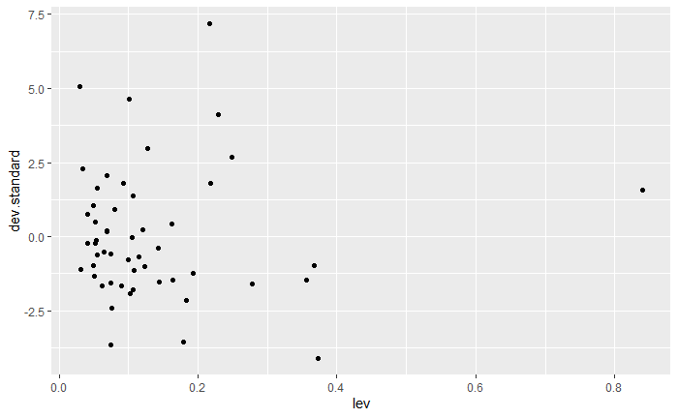
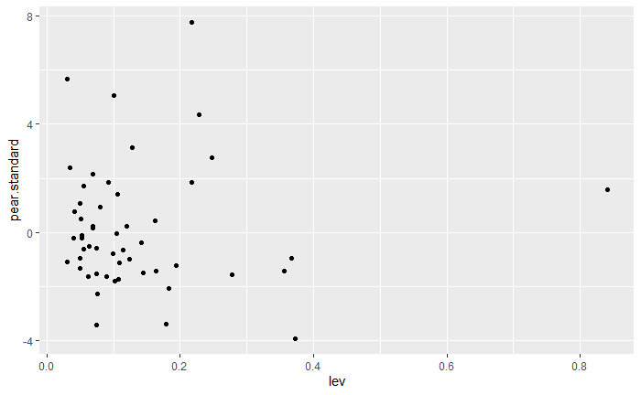
Model Diagnostic Using R(II)
Standardized Deviance residual vs. leverage
Standardized Pearson’s residual vs. leverage

Slide 72
Model Diagnostic Using R(III)
Cook’s distance vs. leverage
Try to delete the outlying data points and see how much change in estimates of coefficients.

Slide 73
Model Diagnostic Using SAS(I)
SAS Code:
ods output OBSTATS = OBSTATS;
proc genmod data = nursing ;
class RURAL (param = ref ref = first);
model BED = RURAL PCREVc NSALc FEXPc
PCREVc* FEXPc NSALc * FEXPc/link = log
dist = poi offset = logTDays OBSTATS;
run;

